Slide 1
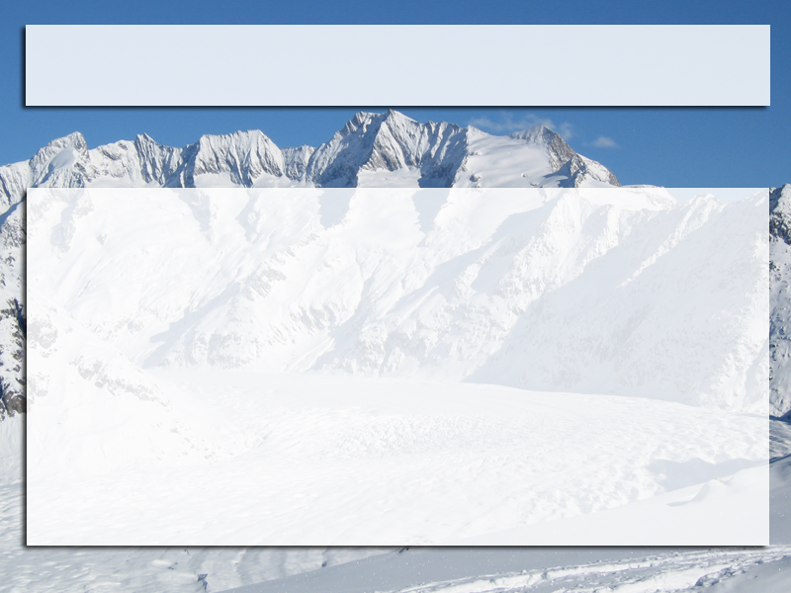
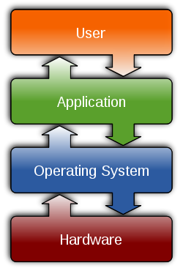
Operating systems
Common features
Process management
Interrupts
Memory management
File system
Device drivers
Networking (TCP/IP, UDP)
Security (Process/Memory protection)
I/O

Slide 2
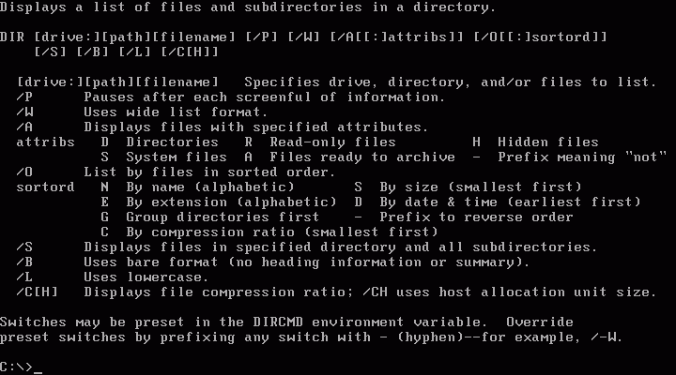
MS-DOS

Slide 3
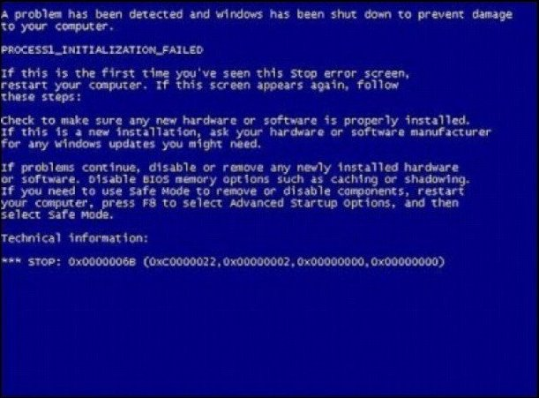
Microsoft Windows

Slide 4
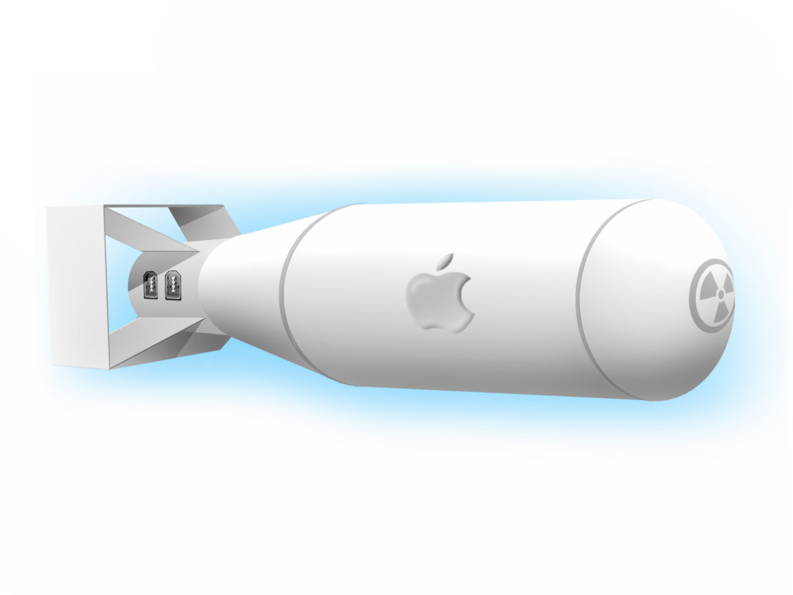
Mac OS X

Slide 5

GNU/Linux

